Slide 1
Install Python and Pycrash
November 18, 2020

Slide 2
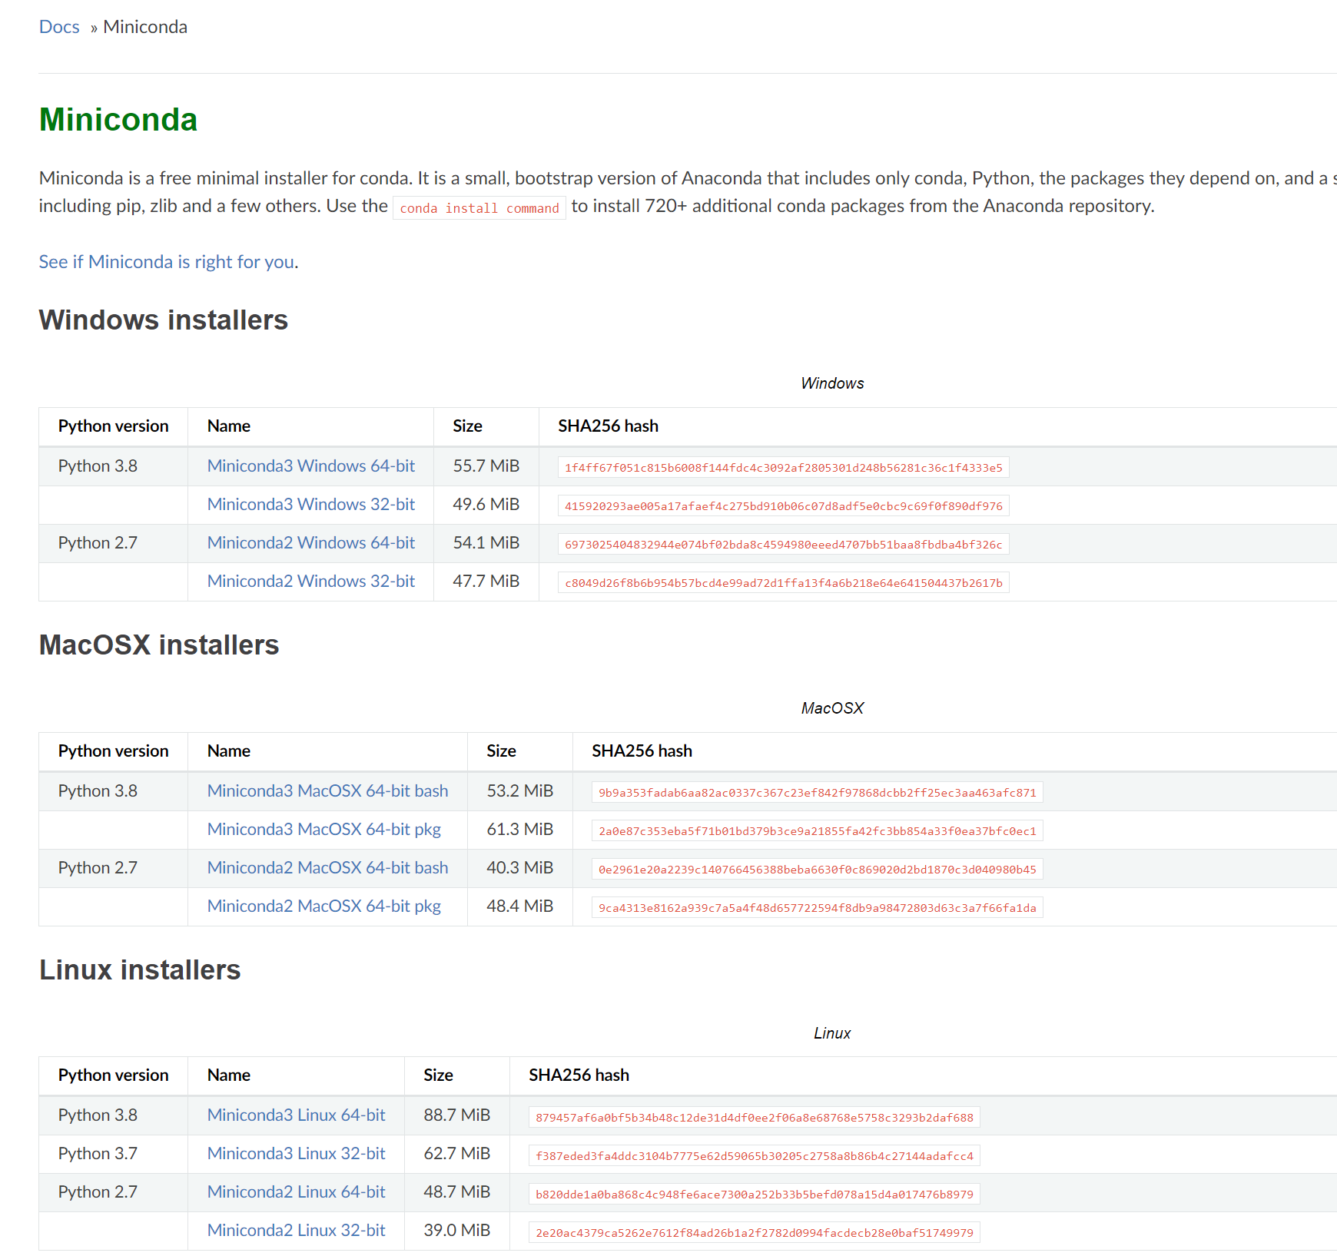
Download and Install Python
I recommend Miniconda if you are new to Python
https://docs.conda.io/en/latest/miniconda.html
Choose the latest version
Create a virtual environment for Pycrash
This will create an isolated environment of the python packages for Pycrash and your related work
https://docs.conda.io/projects/conda/en/latest/user-guide/tasks/manage-environments.html
Activate your environment
conda activate venv (replace venv with the name of your environment)
You’ll need to activate this environment before using Pycrash
Install the necessary packages
Depending on your OS, there may be other packages that you need to install. This should be obvious, and you will get an error with the name of the missing package you need to install. Just Google that name and it will tell you how to install it with conda.
Required packages:
pandas
numpy
scipy
tabulate
cookiecutter
matplotlib
wheel
twine
plotly
PyQt5
xlrd
Jupyter notebook / jupyter lab
pycrash

Slide 3
Python Package installer for Python
Optional – you may need PIP to install Pycrash or other packages –
https://anaconda.org/anaconda/pip
Command line – conda install –c anaconda pip
Example, to install Pycrash, once your environment is active, type “pip install pycrash” into the command line.

